Slide 1
Data Visual Design & Storytelling

Slide 3
Instructor introduction
Schedule:
4 sessions
11 am – 2 pm
1 or 2 short breaks each session
Course objectives:
Create a narrative that accurately supports the data, provides context, and reveals actionable insights
Understand the design principles involved in creating effective and accurate visualizations
Recognize misleading or inaccurate charts and graphs provided by others

Slide 5


You should have received the following materials:
Slides
Participant guide
Needed during class
Contains activities, a data science glossary, information about popular data science tools, and more!

Slide 6
Day 1
The basics of data visualization
Getting started with data visualization
The anatomy of a chart
Day 3
Visual design theory
Common mistakes
Misleading statistics and visual distortions
Day 2
Common charts and graphs
Choosing a visual
Reducing chart clutter
Day 4
Data storytelling
Notes:
The purpose of this slide is to introduce the agenda for the course.
Note that there are several things organizations need to become more data driven: good data, resources, an enabling culture, and knowledge
Day 1 gives and overview and covers data + resources
Day 2 covers the enabling environment and begins a midpoint group project about leveraging data in the workplace
Day 3 goes into more depth on data science methods to increase knowledge and lets you refine your project
Day 4 covers presenting results optimally, accurately, and honestly

Slide 7
The basics of data visualization
Getting started with data visualization
The anatomy of a chart
What is data visualization?
What is data visualization used to do?
Notes:
The purpose of this slide is to indicate the start of the section.

Slide 8
Polling question
Where are you joining us from today?
Home
Office
Somewhere else

Slide 9
Polling question
What is the primary reason you are taking this course?
I tell stories with data as part of my job.
I want to be a better consumer of data.
I want to obtain marketable skills.
Other

Slide 10
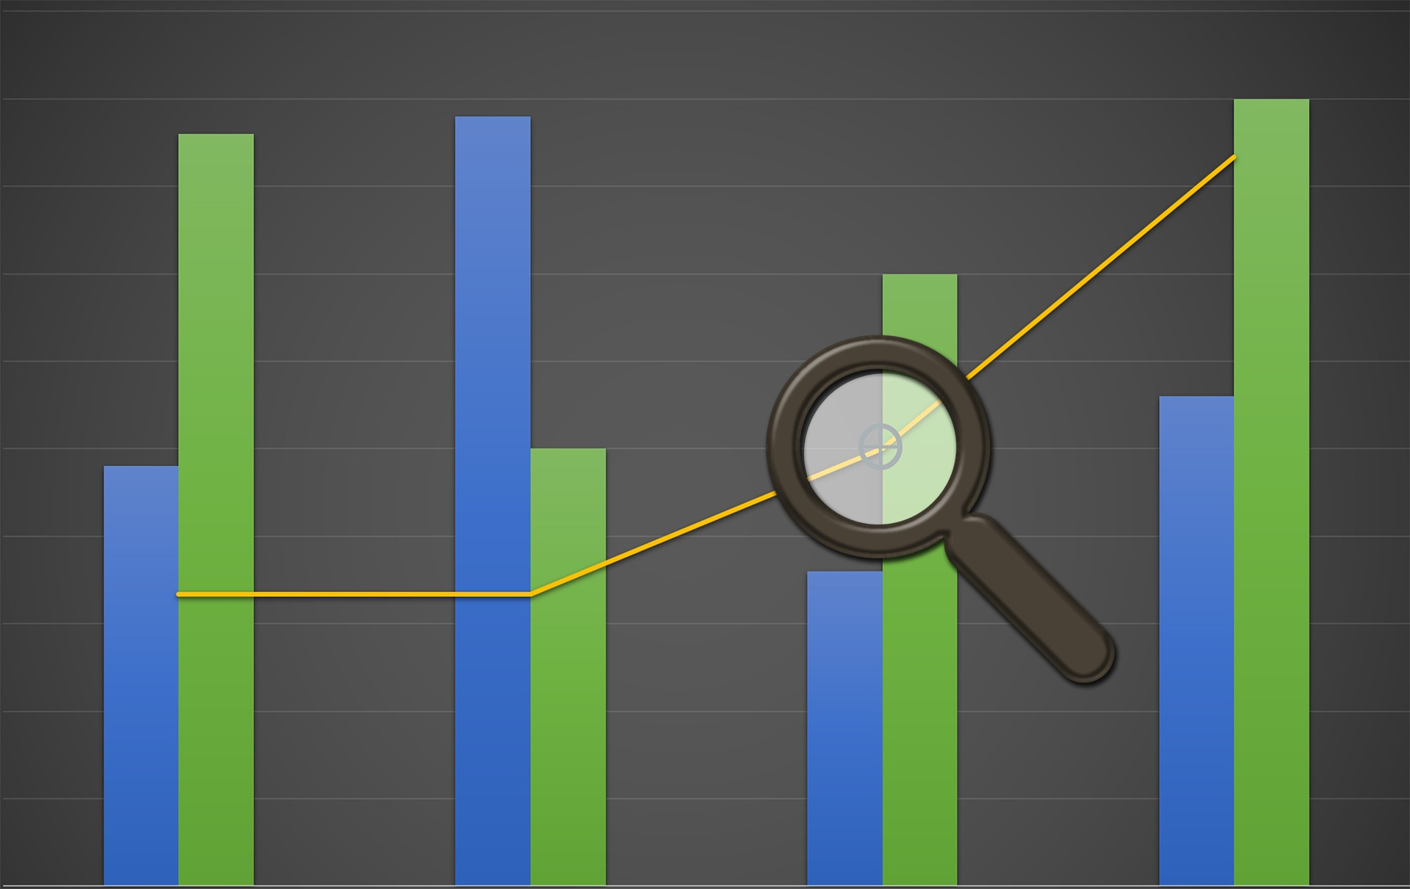
What is data visualization?
Data visualization is any attempt to make data more easily digestible by rendering it in a visual context.
Common data visualizations include tables, charts, graphs, and dashboards.
Notes:
The purpose of this slide is to define data visualization.

Slide 11
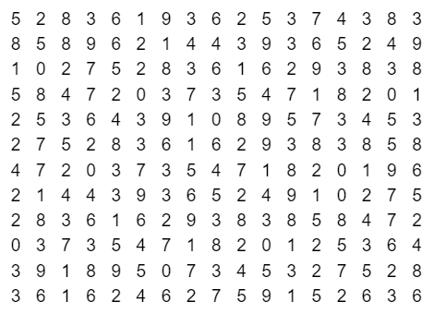
Data viz example
Count how many times the number 7 appears in the grid below.
Notes:
GIVE learners a few minutes to complete the activity.

Slide 12
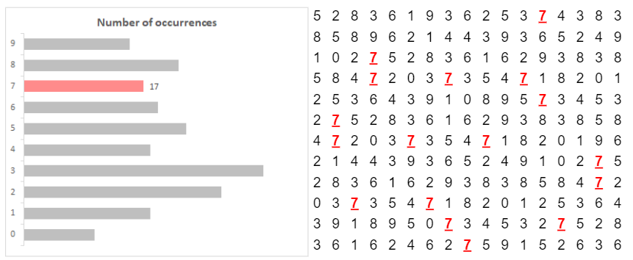
Data viz example
Is it easier to tell now?
Notes:
ASK the students if this makes it easier to tell how many 7s there are. EMPHASIZE both speed and accuracy.

Slide 13
Exploratory data analysis
Exploratory data analysis (EDA) is the process of reviewing new data to discover patterns, to spot anomalies, to test hypotheses, and to check assumptions.
Just like in our counting example, EDA is made easier by using summary statistics and data visualizations.
Often, summary statistics alone aren’t enough.
Notes:
EXPLAIN that what we just did with the 7s was exploratory analysis.

Slide 14
EDA example
MONTH | SALES REP 1 | SALES REP 2 | SALES REP 3
1-Jan | 101 | 34 | 171
2-Feb | 199 | 111 | 354
3-Mar | 300 | 633 | 460
4-Apr | 405 | 313 | 370
5-May | 495 | 409 | 145
What insights can you draw from this data?
Notes:
The purpose of this slide is to show three simple datasets.
ASK students to think about what insights they may be able to develop based on this information. EXPECTED ANSWER: not much.

Slide 15
EDA example
MONTH | SALES REP 1 | SALES REP 2 | SALES REP 3
1-Jan | 101 | 34 | 171
2-Feb | 199 | 111 | 354
3-Mar | 300 | 633 | 460
4-Apr | 405 | 313 | 370
5-May | 495 | 409 | 145
SUM | 1,500 | 1,500 | 1,500
AVERAGE | 300 | 300 | 300
What insights can you draw from this data?
Notes:
The purpose of this slide is to show three simple datasets with summary statistics.
ASK students to think about what insights they might be able to draw based on this information now that there are summary statistics. EXPECTED ANSWER: students may conclude that the datasets are relatively similar given that they total the same amount and have the same average.

Slide 16
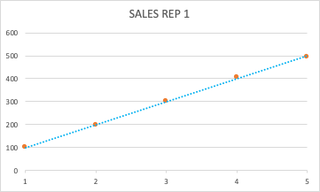
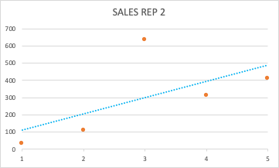
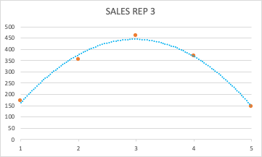
EDA example
MONTH | SALES REP 1 | SALES REP 2 | SALES REP 3
1-Jan | 101 | 34 | 171
2-Feb | 199 | 111 | 354
3-Mar | 300 | 633 | 460
4-Apr | 405 | 313 | 370
5-May | 495 | 409 | 145
What insights can you draw from this data?
SUM | 1,500 | 1,500 | 1,500
AVERAGE | 300 | 300 | 300
Notes:
The purpose of this slide is to show three simple datasets, visualized as scatterplots with trendlines.
ASK students to think about what insights they have on this data now that it’s visualized. REVIEW your insights, which may include:
Sales rep 1 – sales are steadily increasing
Sales rep 2 – sales are steadily increasing, but March was a great month for them and it’s skewing their average upwards. May want to check in with the rep to see what lessons learned they might have from March
Sales rep 3 – sales were increasing until March at which point they began to decline again. May need to check in with the rep to see what issues they might be having.

Slide 17
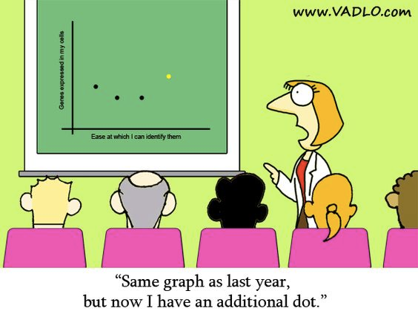
Explanatory data
We also use data visualization to transform raw data into something compelling for an external audience.
Using visualizations incorrectly can cause you to lose your audience, lose the value in your data, and ultimately lead to poor decision making.
Notes:
The purpose of this slide is to talk about how visualizations can be used to explain data to others.
REFERENCE the comic and NOTE that a lot of people struggle to present data in the best way possible and that’s why we’re here today.

Slide 18
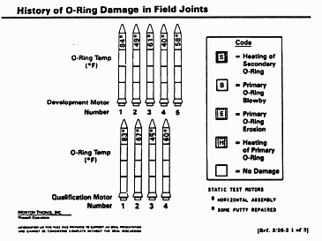
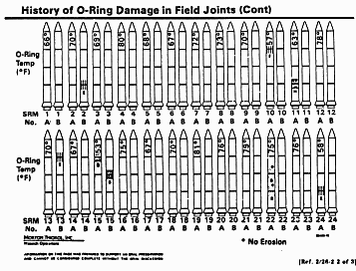
Example: The Challenger
On January 27, 1986, concerned engineers presented data and the following charts to try to illustrate the damage cold temperatures would have on the O-rings of the Challenger space shuttle.
Source: Presidential Commission on the Space Shuttle Challenger Accident, vol. 5 (Washington, DC: US Government Printing Office, 1986.) pp. 895-896.
Notes:
The purpose of this slide is to discuss the visualizations used by engineers to try and stop the launch of the Challenger space shuttle.
Optional class questions:
What relationship do the charts show?
Are these charts effective in presenting the relationship between temperature and O-ring damage? Why?

Slide 19
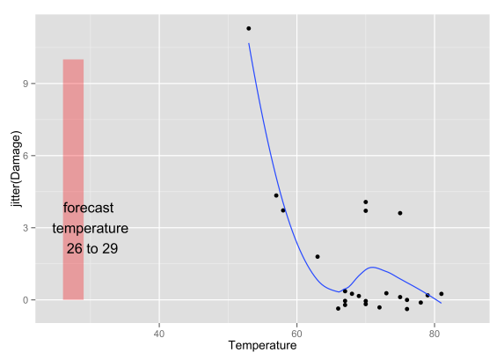
Example: The Challenger
January 28, 1986, the Challenger space shuttle exploded within seconds of takeoff.
Data visualization legend Edward Tufte argues that the shuttle’s engineers failed to communicate dangers because their data wasn't presented in an easily digestible form.
The chart below shows O-ring damage on the y-axis and temperature on the x-axis.
Is it easier to see the issue?
https://vizdatar.wordpress.com/2015/05/06/space-shuttle-challenger-explosion-2/
Notes:
The purpose of this slide is to discuss the visualizations used by engineers to try and stop the launch of the Challenger space shuttle—how they could be improved and what their impact was.
Additional info: https://www.asktog.com/books/challengerExerpt.html

Slide 20

Example: Space junk
“Space junk has been increasing over the last few decades, and collisions could increase if the problem is not kept in check.”
What exactly is the scale of the space junk problem?
What to represent:
number of objects
mass of objects
types of object
distance from Earth
Notes:
The purpose of this slide is to provide another instance of space-related data visualization.
Created by information designer Federica Fragapane for BBC Science Focus to visualize the following observation: “Space junk has been increasing over the last few decades and collisions could increase if the problem is not kept in check.”
“Most of this junk is moving at extremely high speeds – up to seven times the speed of a bullet. At that speed, an object no bigger than a penny could easily destroy a spacecraft. Even more worryingly, a ‘critical mass’ of space junk may be only a few decades away, where one major collision results in an uncontrollable chain reaction, causing untold damage.” -- https://www.sciencefocus.com/space/is-space-junk-a-serious-problem/
The visualization problem was how to represent the scale of the space junk problem to a casual reader.
Created a complex visualization to represent four parameters: the number of objects in orbit and their mass according to the type of object and their distance from earth.
For more information on space junk, see https://www.sciencefocus.com/news/space-junk-we-dont-know-where-over-75-per-cent-of-orbital-debris-actually-came-from/

Slide 21
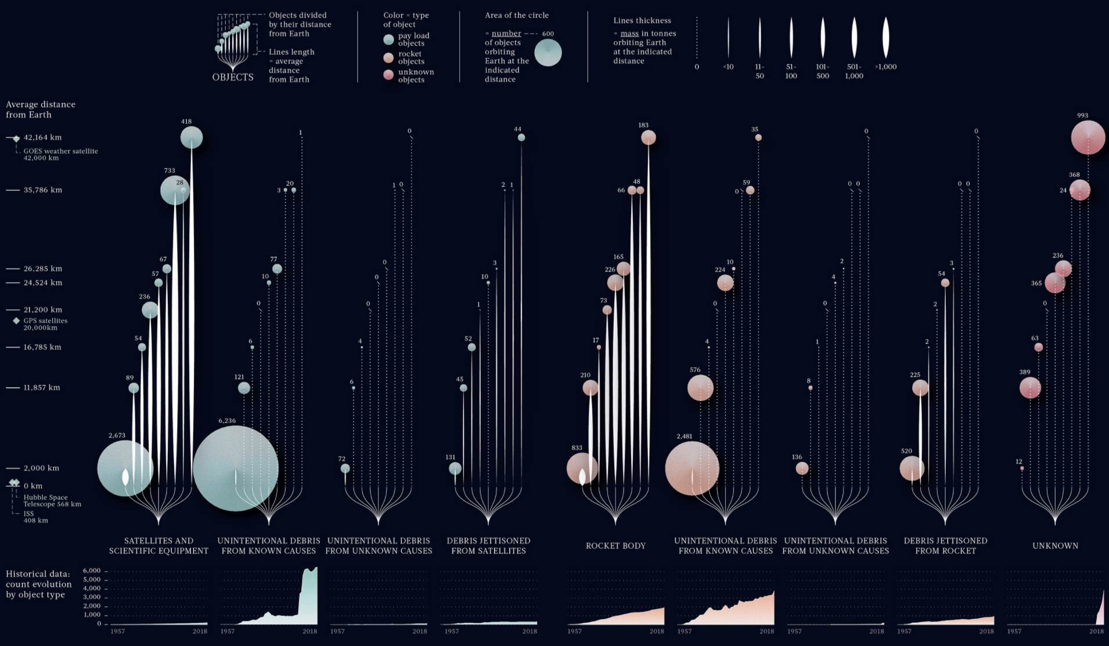
Example: Space junk
Source: https://www.behance.net/gallery/81688575/Space-Junk-BBC-Science-Focus / Data set: https://sdup.esoc.esa.int/
Notes:
The purpose of this slide is to show the final space junk visualization. OPEN a larger version here: https://www.behance.net/gallery/81688575/Space-Junk-BBC-Science-Focus
EXPLAIN how much information this chart contains:
The y-axis measures distance from Earth, with information about space junk at 8 distances.
The x-axis represents types of object in orbit, ranging from satellites and rockets to various kinds of debris. Categories are also broken down by intentionality, attempting to represent human responsibility for the scope of the problem.
The points represent a type of object at a given distance. They vary in size / area based on the number of objects of a certain type at a certain distance.
The lines connecting the category to each point vary in thickness / density based on the mass in tons of each type of object.

Slide 22

Recap
Data visualization is any attempt to make data more easily digestible by rendering it in a visual context.
We can use data visualization to:
perform exploratory data analysis
explain data to others
Notes:
The purpose of this slide is to recap the section.
Note that data viz can be used to:
communicate relationships between data
study large amounts of data
focus the target audience on areas that require attention
identify trends, patterns, and outliers

Slide 23
Break

Slide 24
The basics of data visualization
Getting started with data visualization
The anatomy of a chart
What types of data can be visualized?
How can you begin creating a data visualization?
What tools are available for visualizing data?
Notes:
The purpose of this slide is to indicate the start of the section.

Slide 25

Getting started with data viz
We first need to understand the types of data that exist.
Then, we’ll move on to what you need to consider before visualizing.
Notes:
The purpose of this slide is to give an overview of what will be covered in this section.

Slide 26
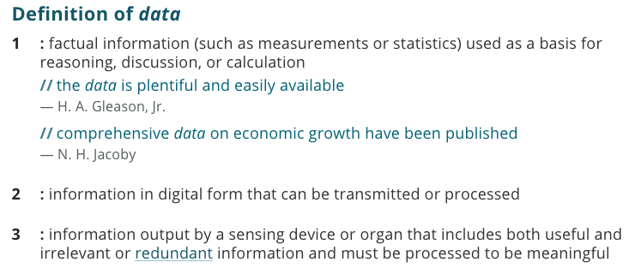
What is data?
Merriam Webster
Notes:
The purpose of this slide is to step back and introduce a definition of data.
HIGHLIGHT the word “factual” and note that data is the most objective way of looking at the way the world is. If correctly collected and analyzed, data cannot be argued with.
HIGHLIGHT the word “digital” and note that we will be primarily be talking about data in digital form today.
Optional chat question: What types of data do you work with on a regular basis?
Source: https://www.merriam-webster.com/dictionary/data

Slide 27
Types of data
Qualitative
Quantitative
Data that approximates or characterizes
Often obtained through interviews, surveys, focus groups, documents, etc.
Examples include:
name
sex (male, female, nonbinary)
observations (e.g., the food was salty)
Data that is measurable and expressed as a number
Often gathered using metrics, tests, experiments, instruments with a ratings scale, etc.
Examples include:
cost
number of applicants
weight
Notes:
The purpose of this slide is to talk about the differences between qualitative and quantitative data.

Slide 28
Types of data
Discrete
Continuous
Data that can only take certain values
Examples include:
the cost of a BMW 7-series
your shoe size
number of people enrolled in this course
Data that can take any value and usually changes over time
Examples include:
the speed of a car during the morning commute
your weight
the time your cat wakes up each day
Notes:
The purpose of this slide is to talk about the differences between qualitative and quantitative data.

Slide 29
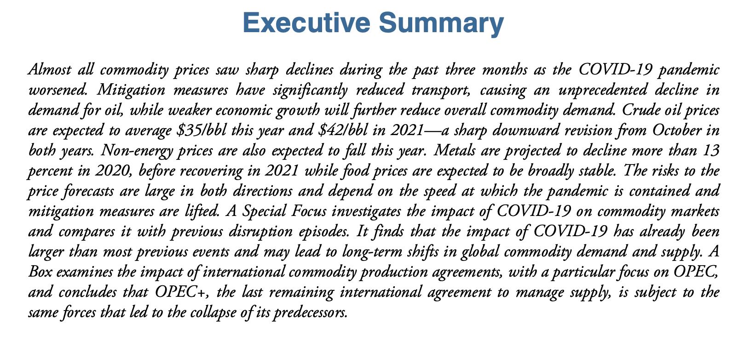
Activity: data types
Turn to page 4 of your participant guide to find the data types activity.
Read the paragraph and answer the questions that follow.

Slide 30
Activity: data types
What examples of quantitative data are included in the summary that you read?
Do you see any examples of qualitative data in this summary? If so, what are they?
Do you see examples of continuous data are mentioned in this summary? If so, what are they?
What types of visualizations might make this summary easier to digest?
Notes:
REVIEW the answers to the questions from the activity:
What examples of quantitative data are included in the summary that you read?
Crude oil prices ($35 bbl, $42 bbl)
Do you see any examples of qualitative data in the summary?
Yes, type of commodity – e.g., oil, metal. (Note: these are further broken out in the full text of the document)
Do you see examples of continuous data are mentioned in this summary?
Not really. However, percentages are often treated as continuous, so some might say commodity price changes expressed as a percentage.
What types of visualizations might make this summary easier to digest?
See next slide

Slide 31
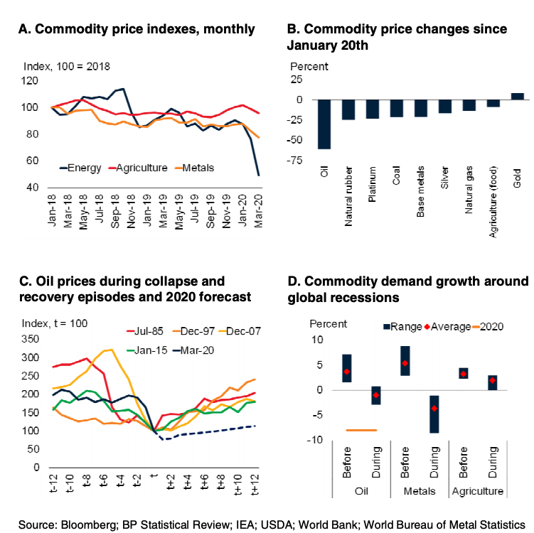
Activity: data types
http://pubdocs.worldbank.org/en/900511587395260657/CMO-April-2020-Executive-Summary.pdf
Notes:
The purpose of this slide is to show the actual visualizations that were used in the World Bank’s Outlook document.
NOTE that different types of data called for different visualizations. Data that was presented over time used line charts. Categorical data was presented as waterfall charts.

Slide 32
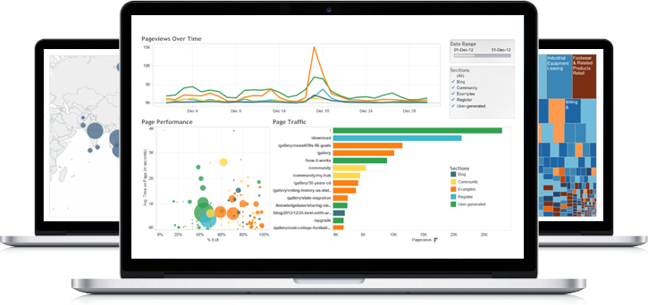
To get started with data viz
Know your audience and understand how it processes visual information. (Who)
Determine what you’re trying to visualize and what kind of information you want to communicate. (What)
Choose a type of visual that conveys the information in the best and simplest form for your audience. (How)
Notes:
The purpose of this slide is to introduce three considerations when you are visualizing data. We go through each in detail in subsequent slides.
REFER back to the World Bank activity noting that the WHO was probably professionals interested in commodity prices, the WHAT was an outlook on the markets, the HOW was a variety of charts based on data type and message.

Slide 33
Who
Know your audience and understand how it processes visual information.
Consider audience familiarity. For example:
High-level executives are generally well-versed in visual data, so use a variety of methods to stand out
Less-experienced audiences will want it kept simple (e.g., pie charts, bar graphs, and word maps)
Consider how the visualization will be used by the audience:
Is it for executives to use to make decisions?
Is it to inform the public?
Notes:
The purpose of this slide is to discuss why it’s important to determine who you are designing a visualization for.
Remember, try not to satisfy everybody. Be specific.

Slide 34

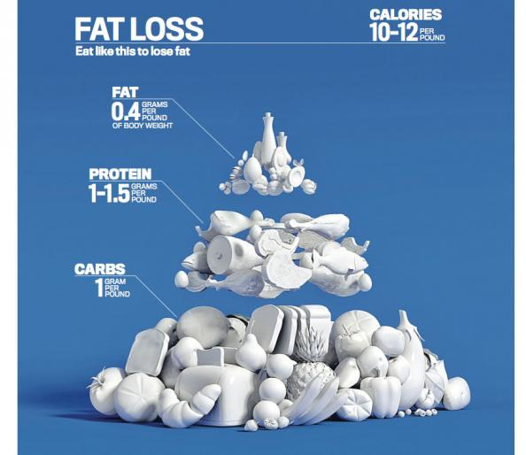
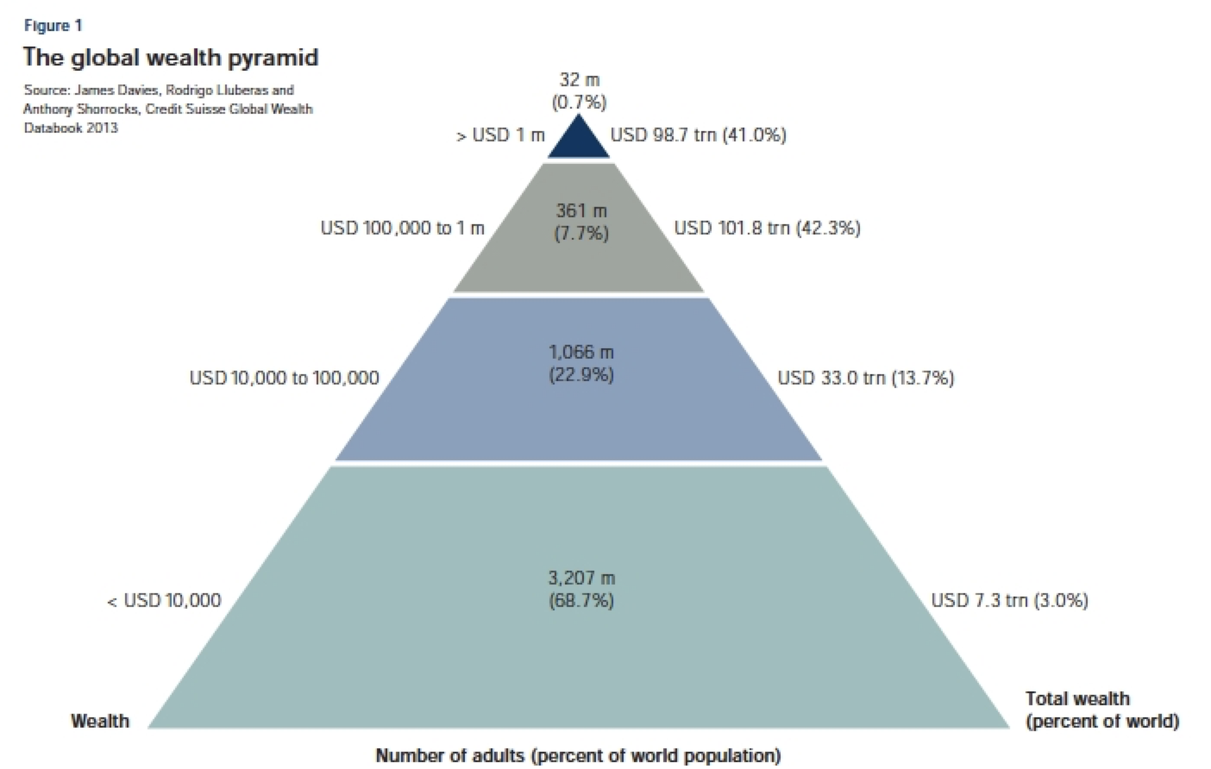
Chat: who is the audience?
https://www.oreilly.com/library/view/learning-highcharts-4/9781783287451/ch08s04.html
http://www.mensfitness.com/nutrition/what-to-eat/mens-fitness-food-pyramid
Notes:
NOTE that these are both pyramid charts and ASK the class to think about how the audiences for these two visualizations might differ. DISCUSS that these charts are both fine, but each is better suited for a particular audience. The left may be better in a corporate report or government document. The right might be better in a magazine or public health campaign.

Slide 35
What
Determine what you’re trying to visualize and what kind of information you want to communicate.
Remember, the audience only knows as much as you tell them:
Do you want them to explore the data on their own? (exploratory analysis)
Do you want to tell a specific story about the data? (explanatory purposes)
If the message is explanatory, consider:
What type of data you have on which to base the analysis?
What are the audience’s topmost concerns or requirements?
What decisions can be made based on the results you provide?
Notes:
The purpose of this slide is to introduce the “what” of data visualization.

Slide 36
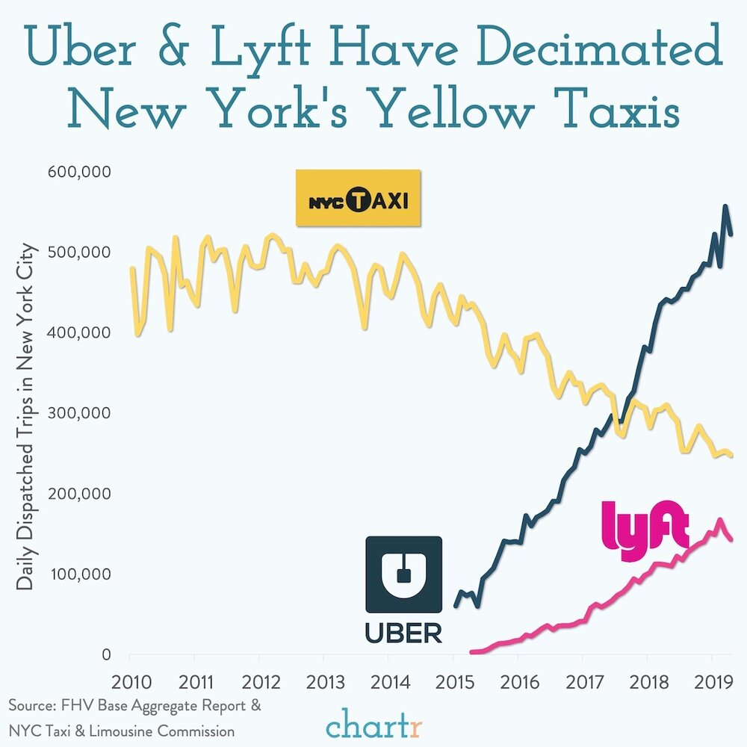
Polling question
Is the message of this data visualization clear?
Yes
No
I’m not sure
Notes:
POLLING QUESTION #3
The purpose of this slide & the polling question is to share a visualization that does a good job of making its message clear.

Slide 37
How
Choose a type of visual that conveys the information in the best and simplest form for your audience.
The type of visual you use depends primarily on two things:
the data you want to communicate
what you want to convey about that data
Then, choose the visual that will be easiest for your audience to read.
Aim for them to “get it” in 30 seconds or less.
37
Notes:
The purpose of this slide is to introduce the concept that there are different ways to visualize data and it’s up to you to determine how to do it.

Slide 38
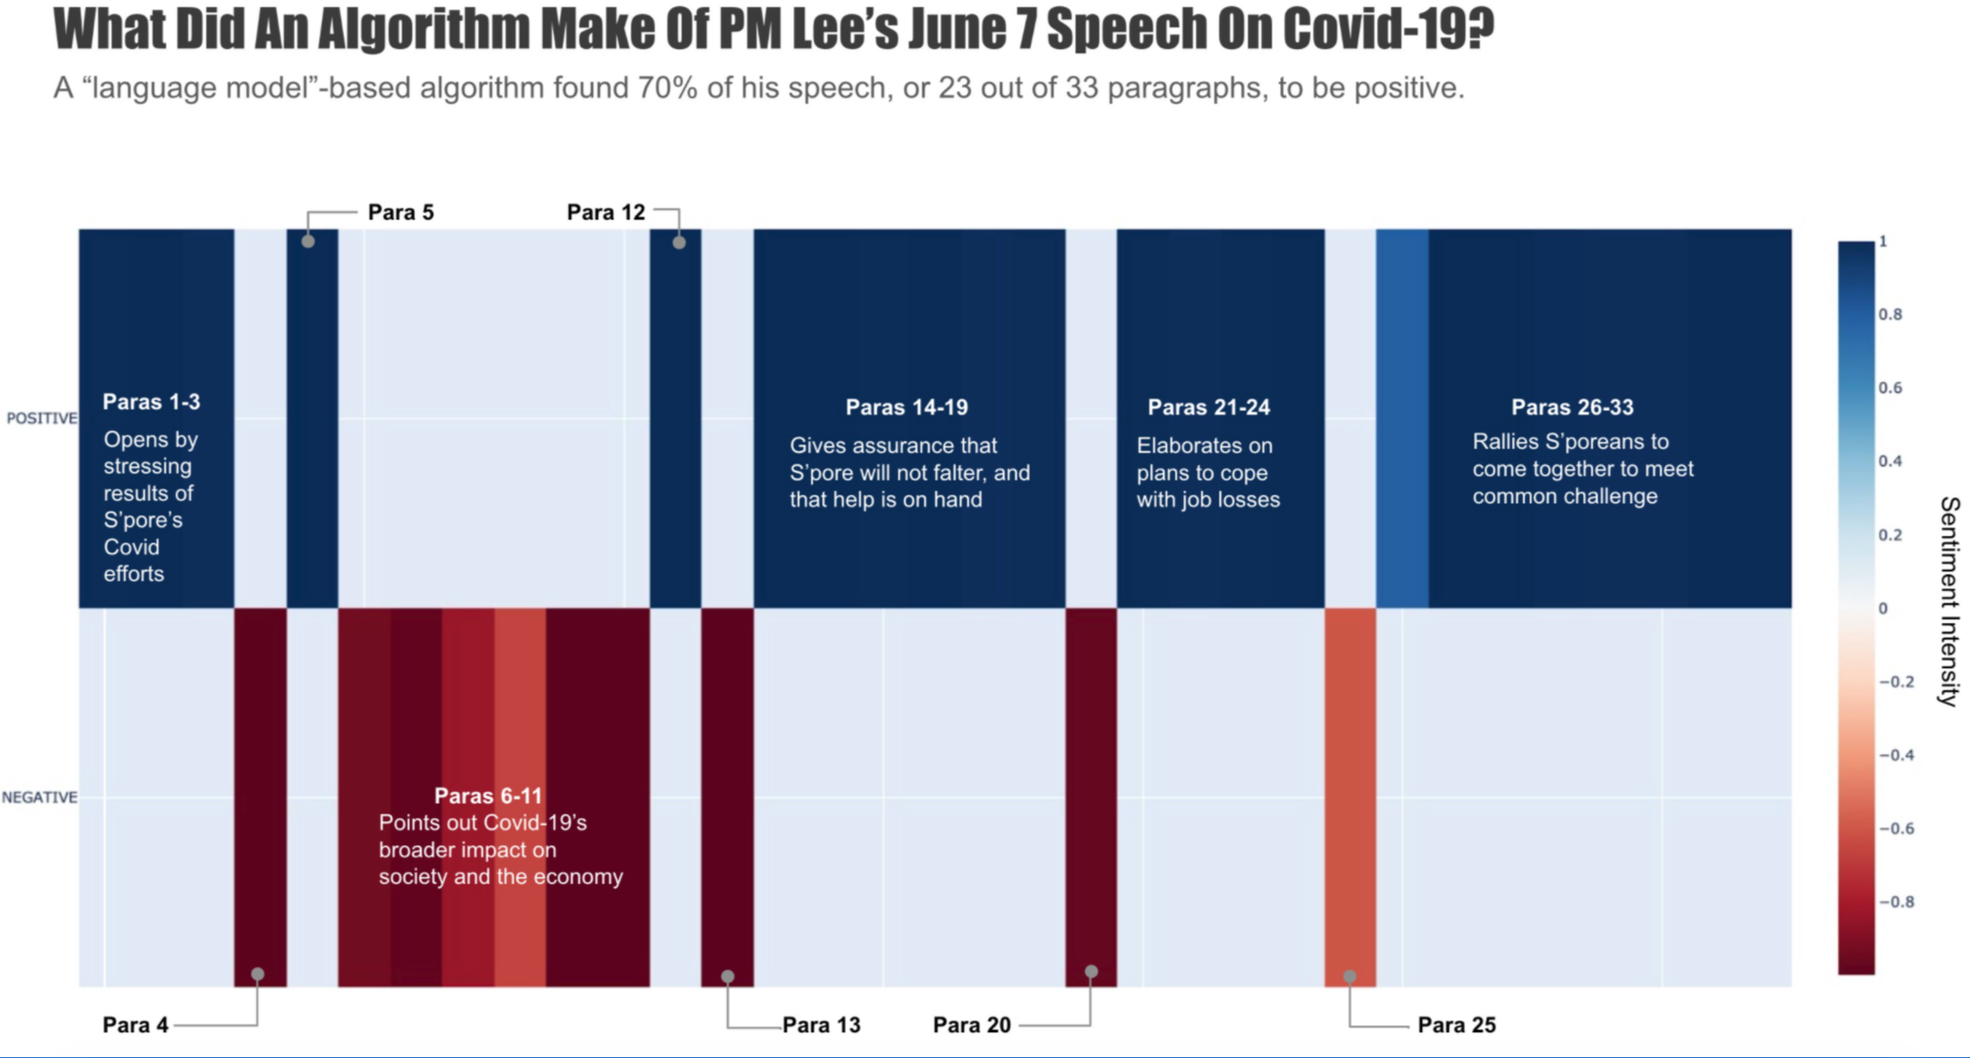
Polling question
Did the algorithm determine this speech to be largely positive or largely negative?
Source: https://towardsdatascience.com/sentiment-analysis-of-political-speeches-using-hugging-faces-pipeline-feature-3109c121d351
Notes:
POLLING QUESTION #3
The purpose of this slide & the polling question is to share a visualization that does a good job of making its message clear.

Slide 39
Chat question
Which factors seem most important to you in choosing a data visualization tool?
Notes:
The purpose of this slide is to say that no one tool is better than the others—which one you should use depends on your specific needs.
Time permitting, you may talk about the pros and cons of the following tools for visualization:
Microsoft Excel
Google Charts
Tableau
Power BI
Python
R and R Studio

Slide 40
Polling question
Which data visualization tools do you use most frequently?
Microsoft Excel
Google Charts
Tableau
R and R Studio
Python
Power BI
Notes:
The purpose of this slide is to say that no one tool is better than the others—which one you should use depends on your specific needs.
Time permitting, you may talk about the pros and cons of the following tools for visualization:
Microsoft Excel
Google Charts
Tableau
Power BI
Python
R and R Studio

Slide 41
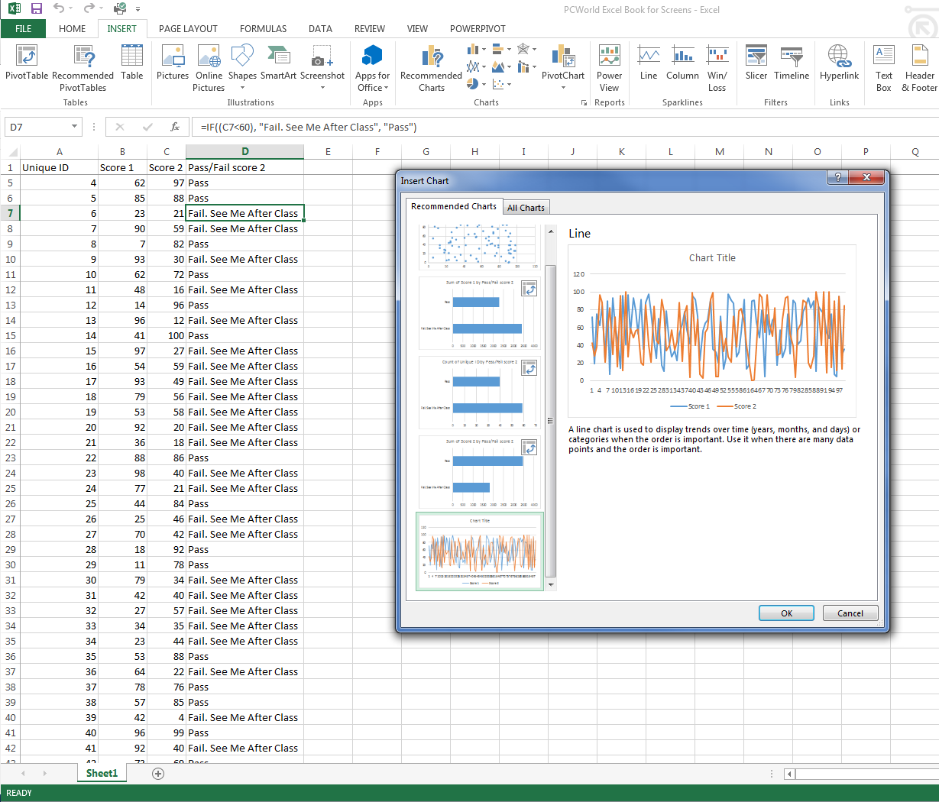
Microsoft Excel
Microsoft Excel allows you to create basic chart types such as pie, line, bar, scatter, and more.
Charts created in Excel can easily be ported to PowerPoint and Word.
Notes:
The purpose of this slide is to give a brief overview of Microsoft Excel’s visualization capabilities.

Slide 42
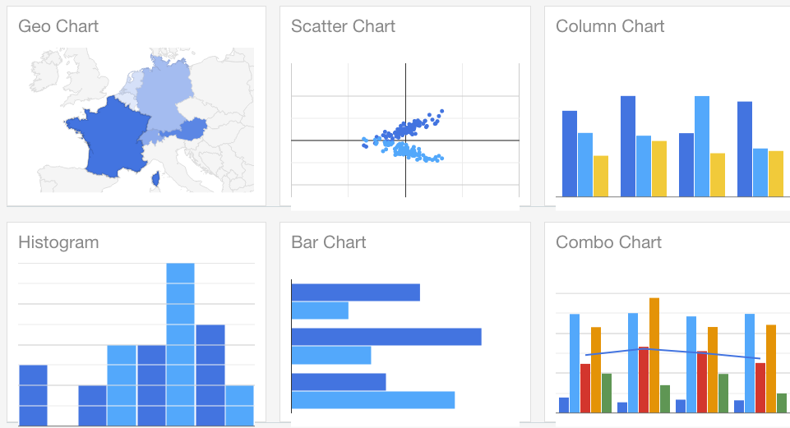
Google Charts
Google Charts is free and open source.
Its chart gallery has many ready-to-use chart types, which can be customized and organized in dashboards.
It allows you to create interactive, animated, and geospatial graphics.
Charts are easy to export for web use.
Notes:
The purpose of this slide is to give a brief overview of Google Charts.

Slide 43
Tableau
Tableau is a tool for creating powerful and insightful visuals.
No programming is required; you can drag and drop.
It allows you to share and collaborate in the cloud for use department- or organization-wide.
Notes:
The purpose of this slide is to give a brief overview of Tableau.

Slide 44
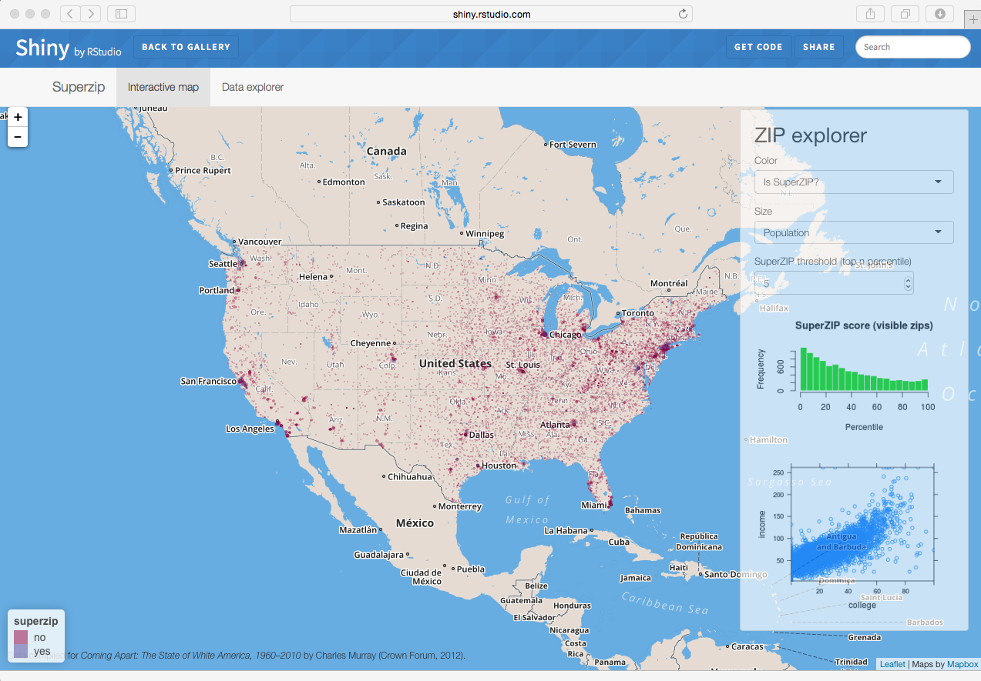
R and RStudio
RStudio is a programming tool that is mainly used for statistical analysis.
It offers functions and libraries to build visualizations and present data.
It is open source and free.
Notes:
The purpose of this slide is to give a brief overview of RStudio’s visualization capabilities.

Slide 45
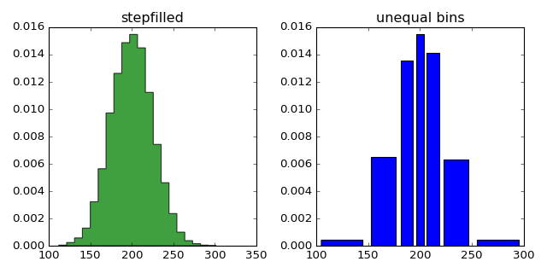
Python
Python is a programming tool.
You'll find libraries for practically every data visualization need.
It is free and open source.
Notes:
The purpose of this slide is to give a brief overview of Python’s visualization capabilities.

Slide 46
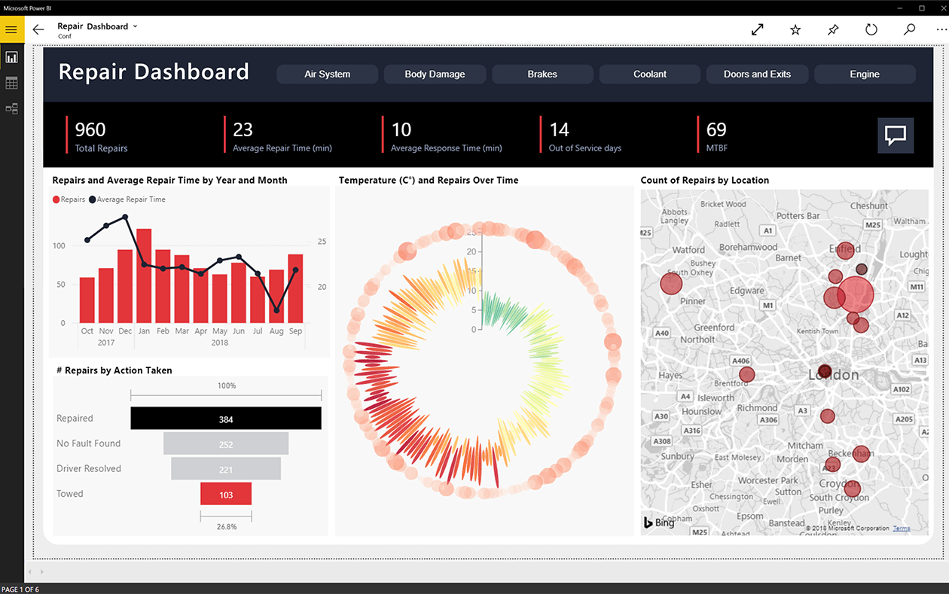
Power BI
Power BI can create interactive visualizations and has business intelligence capabilities.
It has a simple interface.
Many use it to create dashboards.
Notes:
The purpose of this slide is to give a brief overview of Power BI

Slide 47

Infographic tools
An infographic is a collection of imagery, charts, and text that gives an easy-to-understand overview of a topic.
Commonly used tools include Piktochart, Adobe Spark, and Canva.
You can also use general authoring tools like Visio and PowerPoint.
https://www.freepik.com/free-vector/great-infographic-template-with-traveler-checklist_1040519.htm
Notes:
The purpose of this slide is to discuss that there are other tools out there that can be used to create infographics.

Slide 48

Getting started on paper
Many great ideas begin with pencil and paper.
Rapid prototyping visualizations using analog tools allows you to experiment with and compare multiple options.
Avoid sinking time and energy into a tool at the beginning of the process.
Notes:
The purpose of this slide is to discuss that there are other tools out there that can be used to create infographics.

Slide 49
How do you pick the best tool?
See page 32 of the participant guide for a tool selection checklist
Select a tool based on your specific needs
Consider:
budget
organizational restrictions
compatibility with existing systems (e.g., operating systems, hosting platforms)
simplicity of use
ability to create and customize the types of visualizations you need
ability to share and collaborate
security and maintenance
Notes:
The purpose of this slide is to say that no one tool is better than the others—which one you should use depends on your specific needs.

Slide 50
Recap
Before you begin a visualization, consider:
Who the audience is
What your message is
How you can best communicate
Notes:
The purpose of this slide is to recap the section.

Slide 51
The basics of data visualization
Getting started with data visualization
The anatomy of a chart
What are the different elements of a chart or graph?
Notes:
The purpose of this slide is to indicate the start of the section.

Slide 52

The anatomy of a chart
The elements of a chart will vary by chart type, but most have a similar anatomy.
Title
“Y” axis
“X” axis
Axis titles and labels
Gridlines
One or more data series
Legends
Markers or data labels
Trendlines
Notes:
The purpose of this slide is to introduce the section, which is designed to ensure that folks have the vocabulary needed for the rest of the course. The elements listed will each be covered in their own slides.

Slide 53
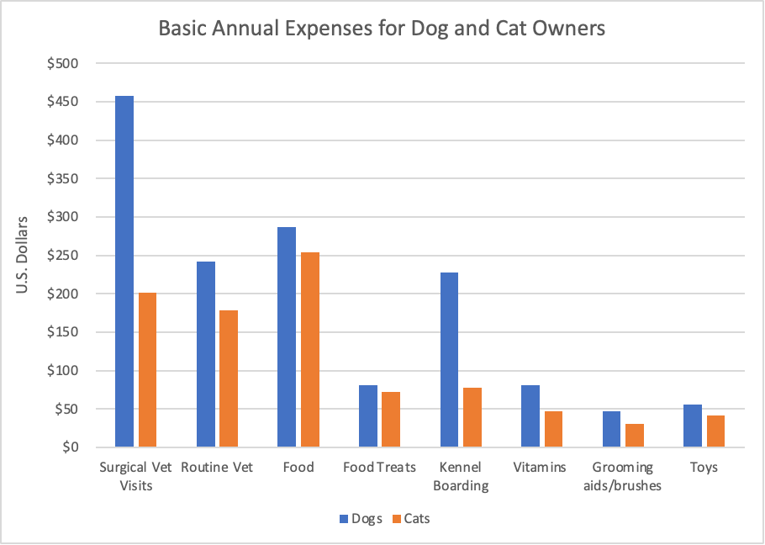
Title
The title explains the chart.
It’s good practice to:
summarize the main point using plain language
include units of representation (e.g., $ in millions)
include the time period (e.g., FY 2019)
keep it short and precise (avoid using articles and adjectives)
https://www.americanpetproducts.org/press_industrytrends.asp
Notes:
The purpose of this slide is to talk about chart titles.
Optional chat question: Does every visualization need a title? ANSWER: It’s a good practice, but there’s always exceptions.
The image is of a clustered column chart about basic annual expenses for pet owners.
Optional chat question: Do you like this title? ANSWER: Not for a standalone visualization, but it might work if it appears in context of a larger report.

Slide 54
“Y” axis
The Y axis displays values.
It is vertical on most charts.
It is segmented into ticks, usually of equal size.
https://www.americanpetproducts.org/press_industrytrends.asp
Notes:
The purpose of this slide is to talk about the “Y” axis
The image is of a clustered column chart
Optional chat question: What types of charts would have a horizontal Y chart? ANSWER: bar charts

Slide 55
“X” axis
The X axis displays category names.
It is horizontal on most charts.
It is segmented into ticks, usually of equal size.
https://www.americanpetproducts.org/press_industrytrends.asp
Notes:
The purpose of this slide is to talk about the “X” axis
The image is of a clustered column chart.
Optional chat question: What type of visuals do not have axes? ANSWER: pie chart, maps

Slide 56
Axis titles and labels
The axis title uses words to explain the entire axis.
The axis labels are words or numbers that mark the different axis ticks.
https://www.americanpetproducts.org/press_industrytrends.asp
Notes:
The purpose of this slide is to talk about axis titles and labels
The image is of a clustered column chart
Optional chat question: Do you think an axis title is necessary on the X axis in this example? ANSWER: Probably not since the currency are fairly obvious

Slide 57
Gridlines
Gridlines are horizontal or vertical lines that extend from the axis.
They can be used to make data easier to read (but sometimes make a chart too cluttered).
https://www.americanpetproducts.org/press_industrytrends.asp
Notes:
The purpose of this slide is to talk about gridlines.
The image is of a clustered column chart

Slide 58
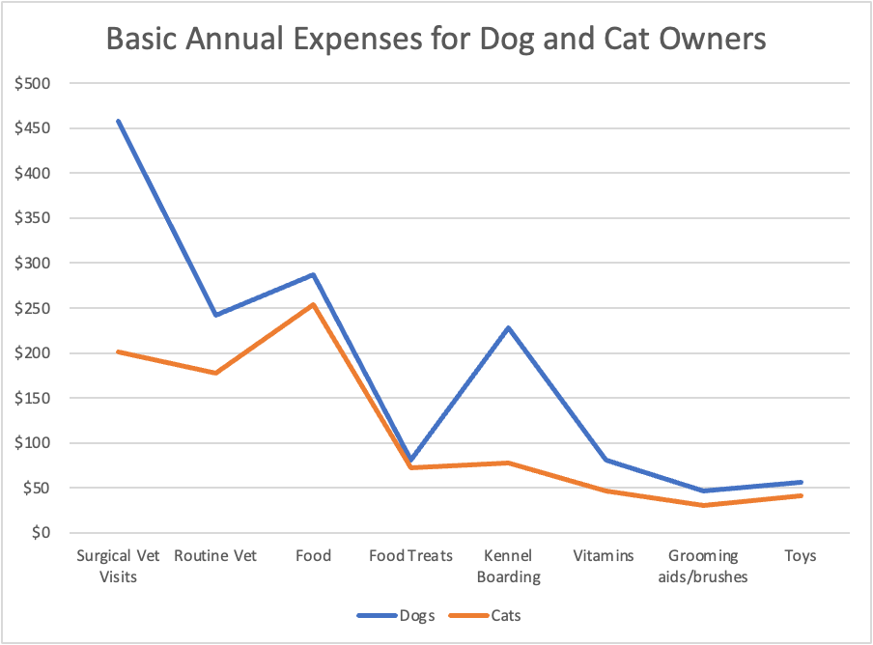
Data series
A data series is a set of related data.
A chart can have one or more series.
Each chart type displays series differently.
Often series correspond to a row of data.
https://www.americanpetproducts.org/press_industrytrends.asp
Notes:
The purpose of this slide is to talk about data series.
The image is of a line chart

Slide 59
Legend
A legend shows what kind of data is represented in the chart.
It may identify patterns, colors, or symbols associated with the markers of a chart data series.
https://www.americanpetproducts.org/press_industrytrends.asp
Notes:
The purpose of this slide is to talk about legends
The image is of a line chart
Optional chat question: What do you think about this legend? Is it necessary? Could it be better?

Slide 60
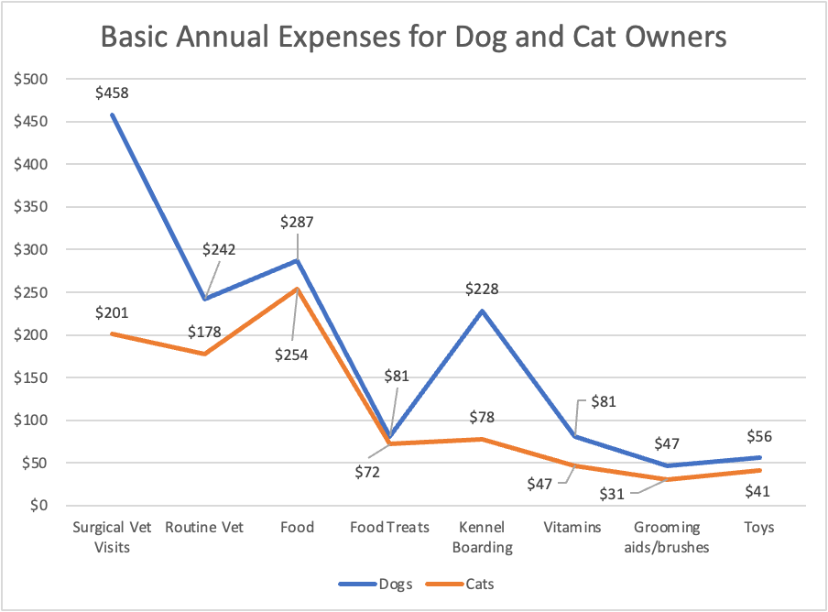
Markers / data labels
Markers, or data labels, identify a single data point.
They can be used on all data points in a series or only some.
They can be a good way to emphasize a particular piece of data on the chart.
https://www.americanpetproducts.org/press_industrytrends.asp
Notes:
The purpose of this slide is to talk about markers / data labels
The image is of a line chart

Slide 61
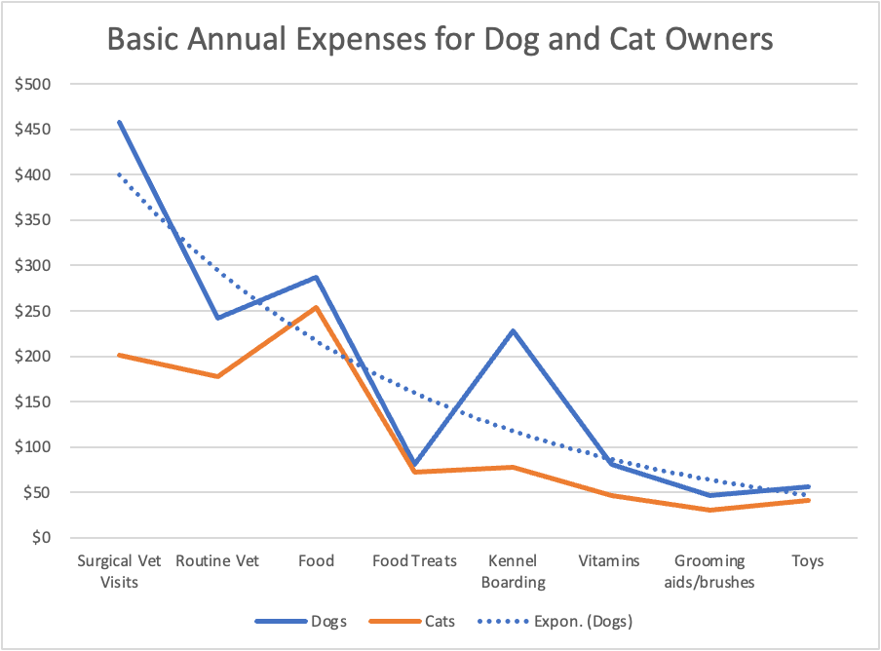
Trendline
A trendline is a line that shows the general pattern or overall direction of the data.
It can be straight or curved.
https://www.americanpetproducts.org/press_industrytrends.asp
Notes:
The purpose of this slide is to talk about trendlines.
The image is of a line chart with a polynomial trendline.

Slide 62

Recap: anatomy of a chart
Elements common to most charts include:
Title
“Y” axis
“X” axis
Axis titles and labels
Gridlines
One or more data series
Legends
Markers or data labels
Trendlines
Notes:
The purpose of this slide is to introduce the section, which is designed to ensure that folks have the vocabulary needed for the rest of the course. The elements listed will each be covered in their own slides.

Slide 63
Activity: anatomy of a chart
Turn to page 6 of your participant guide to find the anatomy of a chart activity.
Review the charts and name the circled elements from the options provided.
Notes:
This activity asks students to label the parts of charts using a word bank. The next two slides will help the instructor to debrief the exercise.
Suggested time to complete: 5 minutes

Slide 64
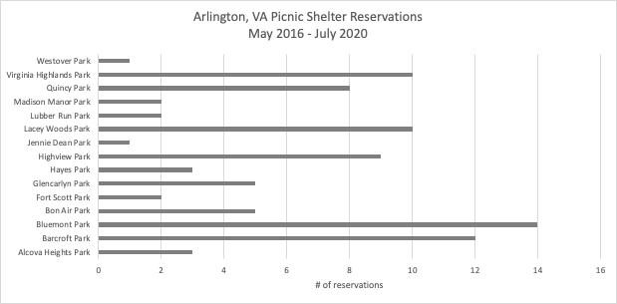
Activity: anatomy of a chart
A
D
B
C
Notes:
REVIEW the answers:
A = title
B = axis label
C = axis title
D = gridline

Slide 65
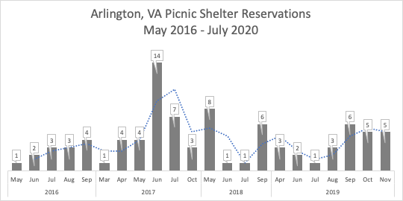
Activity: anatomy of a chart
E
G
F
Notes:
REVIEW the answers:
E = marker / data label
F = data series
G = trendline

Slide 66
End of Day 1
Questions? Comments?

Slide 67
Data Visual Design & Storytelling
Day 2

Slide 68
Activity: class survey
Please complete the class survey found at: https://www.surveymonkey.com/r/MCJNZQ6
A clickable link can be found on page 8 of your participant guide under class survey – part I .
We will return to this survey data for an activity later in today’s session.
Notes:
TELL students that we want to know a little more about them, so we would like them to take a quick survey.

Slide 69
Chat questions
What kinds of charts, graphs, or other data visualizations do you make most often?
What sorts of audiences do you present your visualizations to?

Slide 70
Common charts and graphs
Choosing a visual
Reducing chart clutter
What charts and graphs are used most often?
How can I determine which chart is most appropriate for my data?
Notes:
The purpose of this slide is to indicate the start of the section.

Slide 71
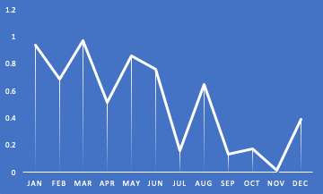
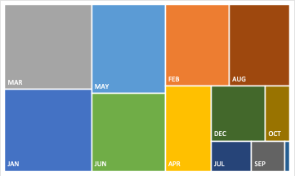
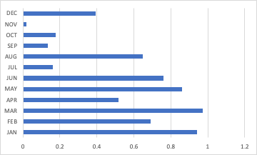
Using appropriate visuals
In this section, we’ll review the most common charts you’re likely to encounter.
Later, we’ll talk about which ones to use in specific situations.
Notes:
The purpose of this slide is to give a quick overview of what’s covered in this section

Slide 72
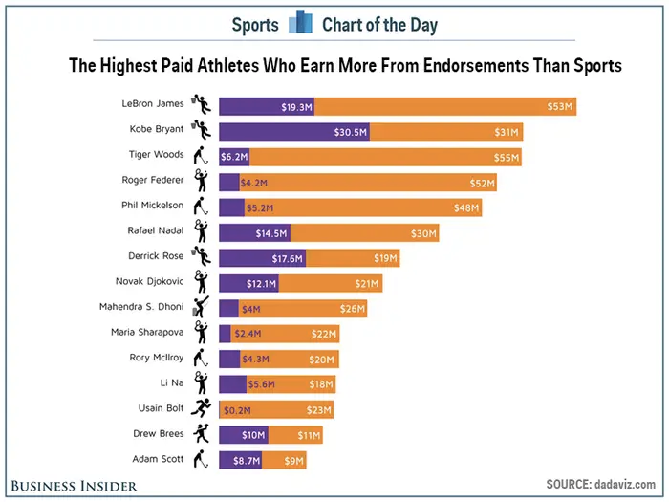
Bar chart
A bar chart is a chart with rectangular bars with lengths proportional to the values that they represent.
One axis of the chart shows the specific categories being compared, and the other axis represents a discrete value.
Vertical bar charts are also called column charts.
Notes:
The purpose of this slide is to give an overview of bar charts.
Optional chat question: What do you like/not like about the example?

Slide 73
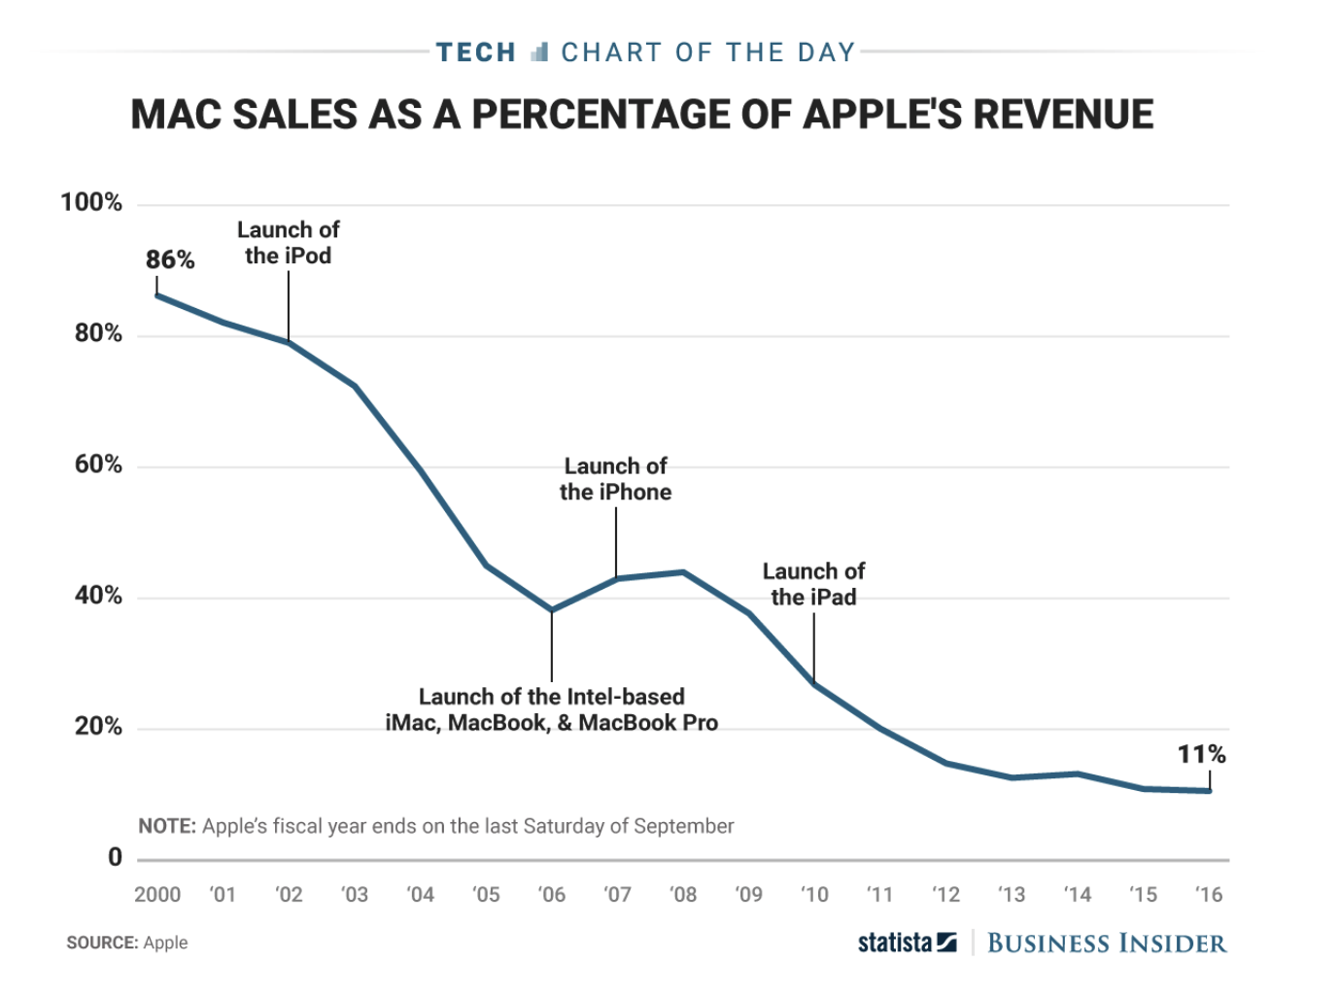
Line chart
A line chart displays information as a series of data points called ‘markers’ connected by straight line segments.
An area chart is a line chart with the area below the lined filled with colors or textures.
http://www.datavizdoneright.com/2017/04/mac.html
Notes:
The purpose of this slide is to give an overview of line charts.
Optional chat question: What do you like/not like about the example?

Slide 74
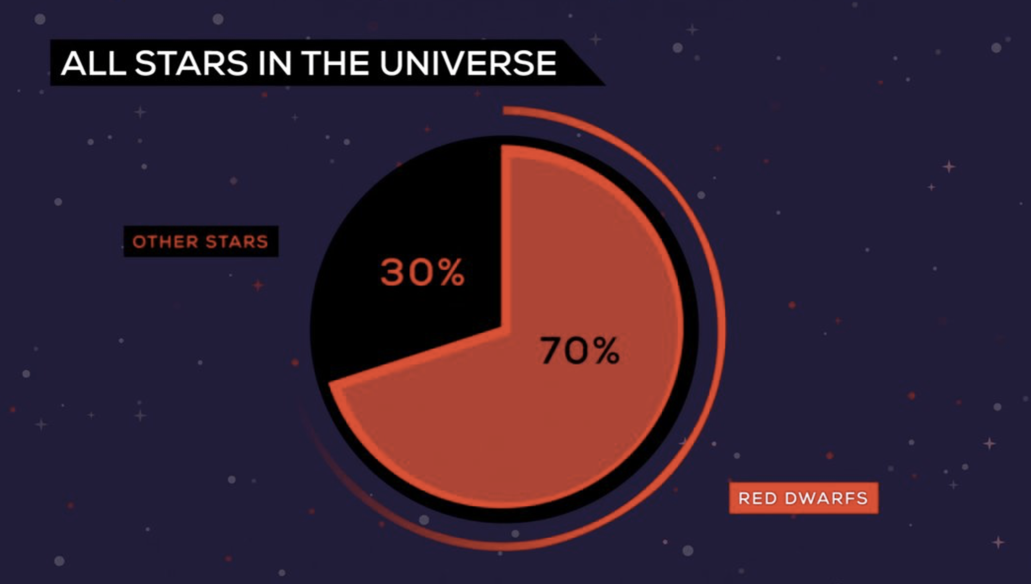
Pie chart
A pie chart is divided into sectors, illustrating numerical proportion.
In a pie chart, the area of each sector is proportional to the quantity it represents.
A doughnut chart is a pie chart with a blank center that can be used to display additional data.
https://www.informationisbeautifulawards.com/showcase/1195-the-last-star-in-the-universe-red-dwarfs-explained?utm_content=buffer0e946&utm_medium=social&utm_source=twitter.com&utm_campaign=buffer
Notes:
The purpose of this slide is to give an overview of pie charts.
Optional chat question: What do you like/not like about the example?

Slide 75
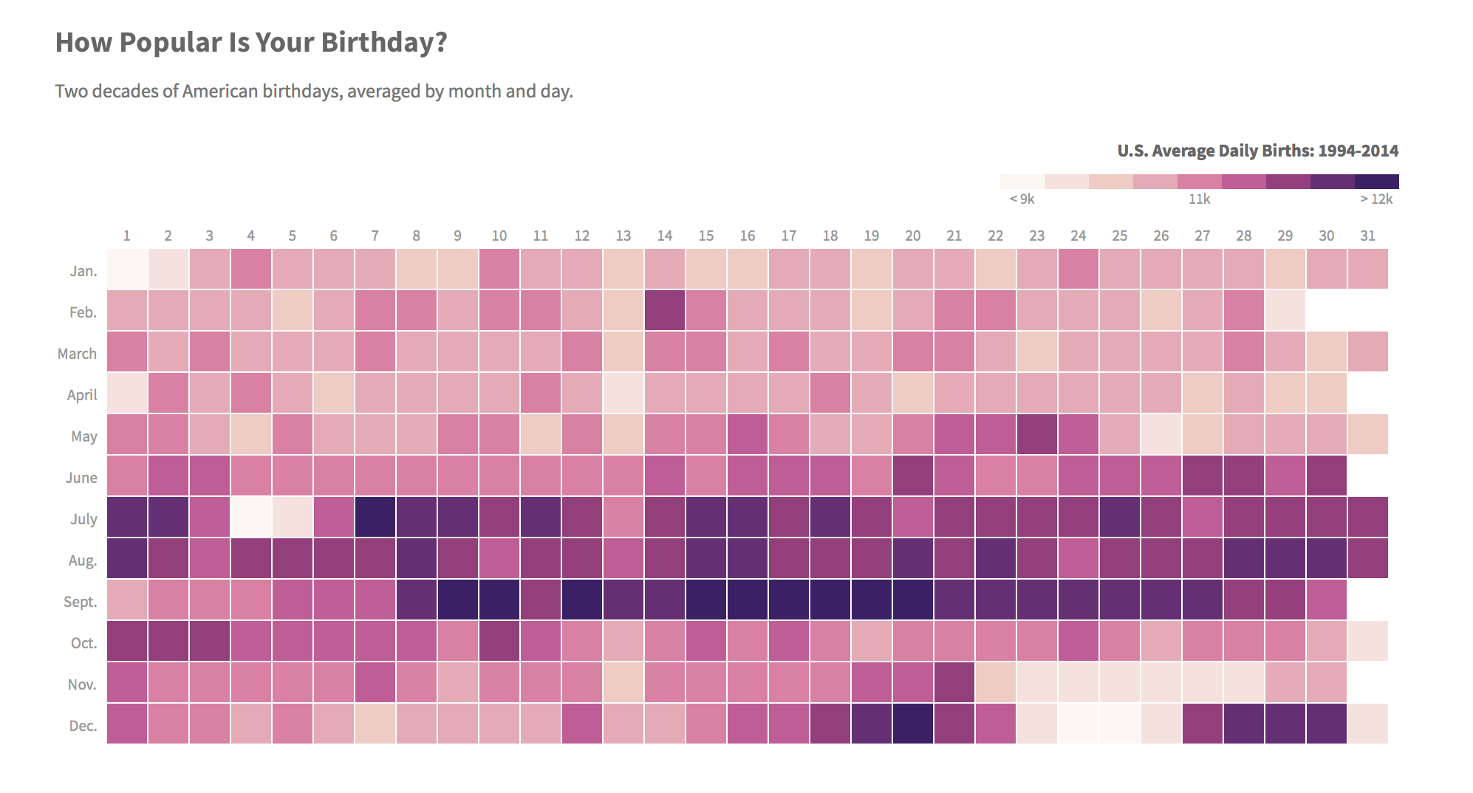
Heatmap
In a heatmap, individual values are contained in a matrix with variations in coloring.
Heatmaps are useful for visualizing variance across multiple variables to display patterns in correlations.
http://thedailyviz.com/2016/09/17/how-common-is-your-birthday-dailyviz/
Notes:
The purpose of this slide is to give an overview of heatmaps.
Optional chat question: What do you like/not like about the example?

Slide 76
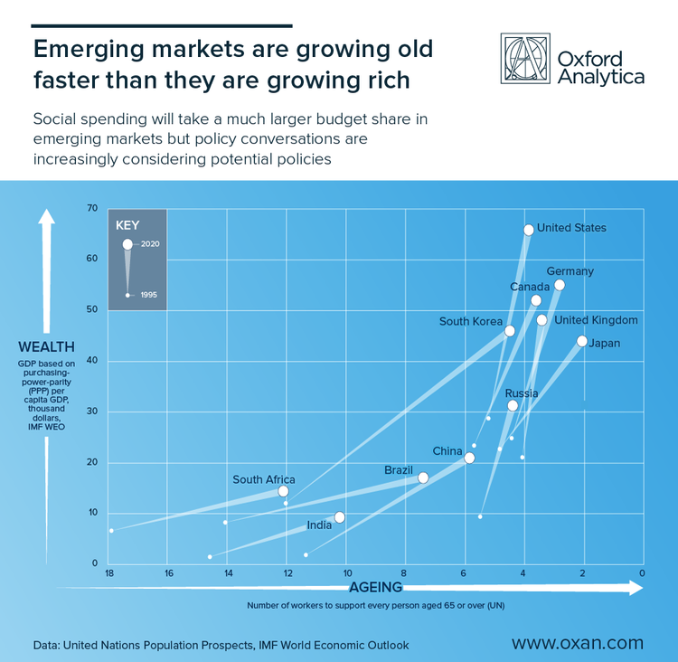
Scatter plot
A scatter plot is a type of diagram that uses coordinates to display values for two variables for a set of data.
The data is displayed as a collection of points, each having the value of one variable determining the positions on the X and Y axes.
Notes:
The purpose of this slide is to give an overview of scatter plots.
Optional chat question: What do you like/not like about the example?
Source: http://www.storytellingwithdata.com/blog/2018/10/23/scores-of-scatterplots
“This has been more controversial than we expected, with argument raging about whether this is a scatterplot or “a cunningly disguised time series” (which I don’t think was intended as a compliment). Sarah and I like the approach of building onto a conventional scatter plot to give an idea of change over time. This chart only shows two points in time – 1995 and 2020 projections, but I think that’s enough given the number of points on the chart. It’s been interesting to look at the countries which are ‘superstar’ performers, and those which have an almost horizontal trajectory, which could spell trouble in the future.”

Slide 77
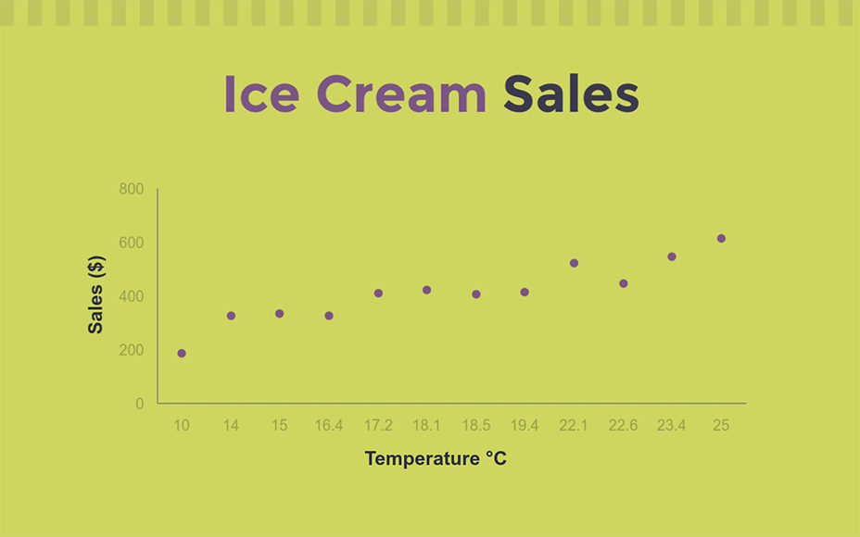
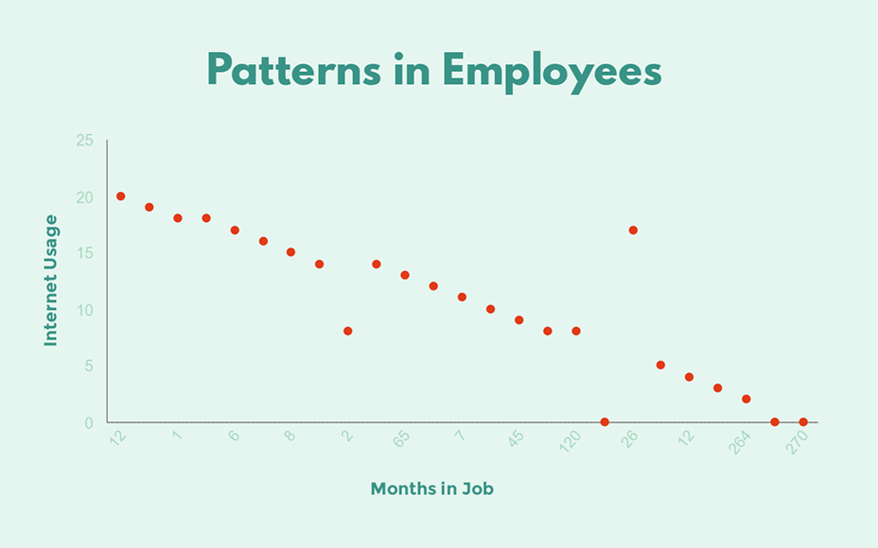
How to read a scatter plot
If the data moves uphill there is a positive relationship between X and Y (as temperature increases, ice cream sales tend to increase)
If the data moves downhill there is a negative relationship between X and Y (as months worked increases, internet usage tends to decrease)
If the data doesn’t have a pattern, then no relationship exists between X and Y.
https://www.visme.co/scatter-plot-maker/
Notes:
The purpose of this slide is to explain how to read a scatter plot.
NOTE that a scatterplot only suggests a relationship between two sets of values. It does not suggest that one causes the other.
More info: https://www.dummies.com/education/math/statistics/how-to-interpret-a-scatterplot/

Slide 78
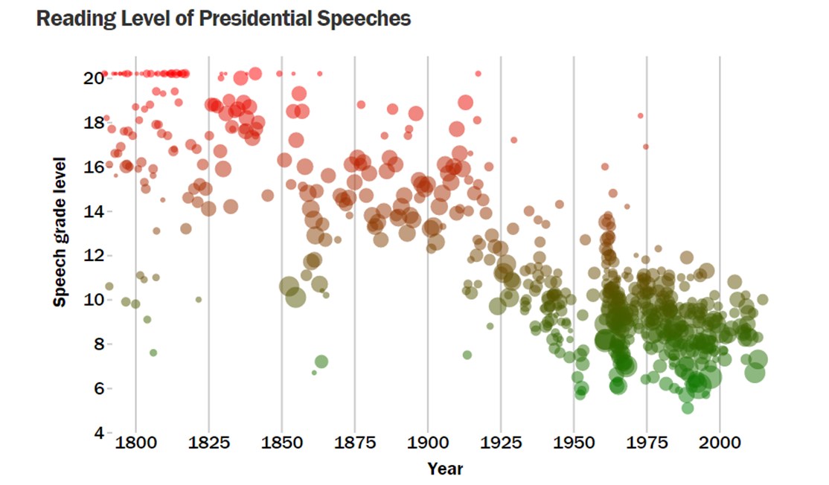
Bubble chart
A bubble chart displays three dimensions of data.
Each entity is plotted as a bubble that expresses two of the values through the xy location and the third through its size.
http://dadaviz.com/i/1276
Notes:
The purpose of this slide is to give an overview of bubble charts.
Optional chat question: What do you like/not like about the example?

Slide 79
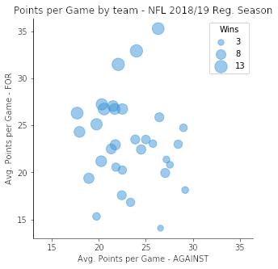
How to read a bubble chart
Look for a relationship between the x and y variables
Positive
Negative
No relationship
Look for patterns in bubble size
consistency in bubble size means there is less variation in the relationship between the variables
https://chartio.com/learn/charts/bubble-chart-complete-guide/
Notes:
The purpose of this slide is to explain how to read a bubble chart.
The example bubble chart above depicts the points scored per game by teams in the regular season of the National Football League in 2018. Each bubble represents a single team’s performance. A bubble’s horizontal position notes the average points scored against that team each game, and the vertical position notes the average points scored by that team each game. Each bubble’s size indicates the number of wins earned by each team, with larger bubbles corresponding to higher win rates. (Ties are worth half a win.) From the plot, we can see that there is a lot more variance in points scored by teams than by their opponents, but there’s no particularly strong correlation between the two. Instead, the main takeaway from the plot comes from the third variable: as teams score more points and allow fewer points from their opponents (towards the upper left), they will earn more victories, as one might naturally expect.

Slide 80
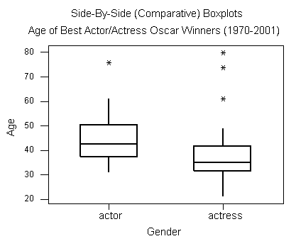
Boxplot
A boxplot displays median, higher/lower quartiles and maximum/minimum.
The spacings between the different parts of the box indicate the degree of dispersion and skewness in the data and show outliers.
https://bolt.mph.ufl.edu/6050-6052/unit-1/one-quantitative-variable-introduction/boxplot
Notes:
The purpose of this slide is to give an overview of boxplots. We will learn how to read them on the next slide and then interpret this one after that.

Slide 81
How to read a boxplot
minimum
median
maximum
outlier
1st quartile
25th percentile
3rd quartile
75th percentile
Notes:
The purpose of this slide is to explain how to read a boxplot.
DEFINE each of the labeled items for the students.

Slide 82
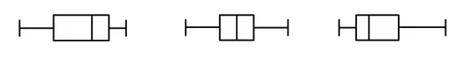
How to read a boxplot
Left-skewed
Symmetric
Right-skewed
When the median is closer to the top of the box, and if the whisker is shorter on the upper end of the box, then the distribution is negatively skewed (skewed left).
When the median is in the middle of the box, and the whiskers are about the same on both sides of the box, then the distribution is symmetric.
When the median is closer to the bottom of the box, and if the whisker is shorter on the lower end of the box, then the distribution is positively skewed (skewed right).
Notes:
The purpose of this slide is to explain how to read a boxplot.
Source: https://www.simplypsychology.org/boxplots.html

Slide 83
How to read a boxplot
 | Actors | Actresses
Minimum | 31 | 21
Q1 | 37.23 | 32
Median | 42.5 | 35
Q3 | 50.25 | 41.5
Maximum | 76 | 80
Takeaways:
In general, actresses win the Best Actress Oscar at a younger age than actors do.
The actors’ ages are more alike than the actresses’ ages. However, the middle 50% of the age distribution of actresses is more homogeneous than the actors’ age distribution.
We have outliers in both distributions.
https://bolt.mph.ufl.edu/6050-6052/unit-1/one-quantitative-variable-introduction/boxplot
Notes:
The purpose of this slide is to explain how to read a boxplot.

Slide 84
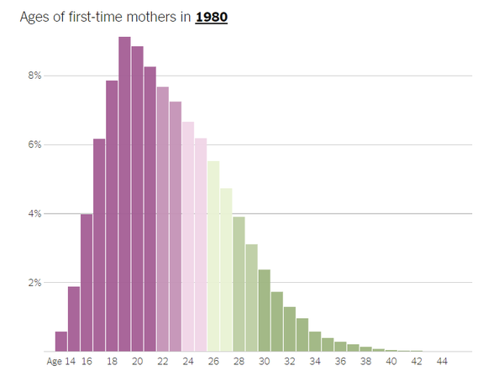
Histogram
A histogram groups numeric data into bins, displaying the bins as segmented columns.
They’re used to depict the distribution of a dataset: how often values fall into ranges.
https://www.nytimes.com/2018/11/22/learning/whats-going-on-in-this-graph-nov-28-2018.html
Notes:
The purpose of this slide is to give an overview of histograms.

Slide 85
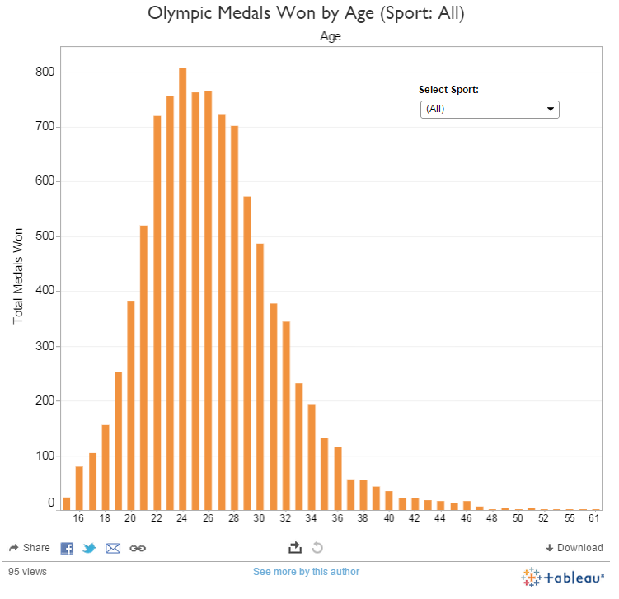
How to read a histogram
The area of the bar (height x width) tells the number of occurrences
Generally there won’t be a gap between the bars because histograms work well with continuous data
Data is split into intervals called bins, which should be neither too small nor large to see patterns
https://www.tableau.com/about/blog/2014/12/5-chart-types-youve-never-tried-tableau-35281
Notes:
The purpose of this slide is to explain how to read a histogram.

Slide 86
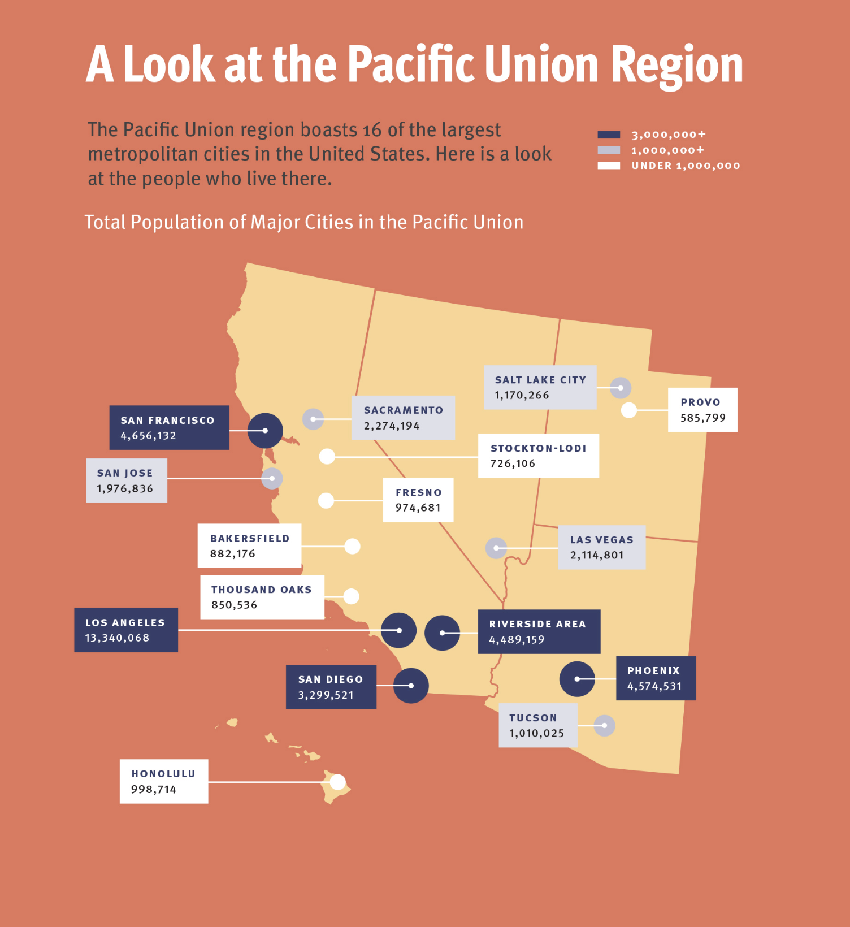
Map
Maps present geographically-related data in a clear and intuitive manner.
Maps are often combined with points, lines, bubbles, and more.
https://dribbble.com/shots/2881738-Infographic/attachments/595499
Notes:
The purpose of this slide is to give an overview of maps.
Optional chat question: What do you like/not like about the example?

Slide 87
Activity: common charts and graphs
Turn to page 9 of your participant guide to find the common charts and graphs activity.
Review the charts and answer the questions that follow.
Check how you did using the answer key on page 12.
Notes:
This activity consists of 10 multiple choice questions. An answer key is provided so there is no need for instructor to debrief. It’s suggested that you combine the activity with the break (10 minutes for activity + 10 minutes break)

Slide 88
Break

Slide 89
Common charts and graphs
Choosing a visual
Reducing chart clutter
How can I choose what type of chart is best for my explanatory goal?
Notes:
The purpose of this slide is to indicate the start of the section.

Slide 90
Choosing the type of visual
Remember, we first define the who and what, and then the how.
The type of visual you choose should depend on the data you want to communicate and the message.
Consider:
How many variables do I want to show?
How many data points are there?
Should values be displayed over time?
Should similar items be grouped?
Notes:
The purpose of this slide is to introduce the section. The remaining slides will go through the different types of data and messages and recommend charts to use as a starting point.

Slide 91
Just a few numbers
…we spent only $75,000 of our $125,000 budget…
…therefore, it is not surprising that only 29 percent of the applications were accepted…
…product A ($12.99) was much more affordable than product B ($59.99)…
Don’t overcomplicate!
Simple text works well when there is just a number or two to share.
Notes:
The purpose of this slide is to talk about visualizing (or not visualizing) just a few numbers.

Slide 92
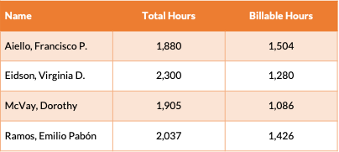
Unique data
Tables are great when communicating to a mixed audience who will look to a particular row of interest or when you need to show different units of measure.
Product | Weight | Price
Toaster (UK) | 1.05 kg | £17,49
Toaster (US) | 3.13 lbs | $29.99
Toaster (South Africa) | 1.07 kg | R239,00
Notes:
The purpose of this slide is to talk about visualizing “unique” data
The top table shows information about total and billable hours. If distributed for review by the individuals listed, it’s easiest for them to just find their name in alphabetical order.
The bottom table shows information about toasters. There are different units of measure in the weight and price columns. If you convert them all into the same measure a visualization might work, but that might not always be what you want (e.g., a product list at a call center that takes calls from around the world).

Slide 93
Comparisons
Comparisons help us evaluate and compare values between two or more data points.
Examples include:
Total number of visitors per month, grouped by country of residence, to see where most visitors come from and where to put more efforts
Quarterly expenditures for a particular project, to spot trends or performance issues
Number of COVID-19 patients by city, highlighting the prevention efforts undertaken in that area
Go-to visualizations: bar charts, pie charts, & line charts.
Notes:
The purpose of this slide is to showcase ideas for visualizing comparisons.
Optional chat question: How would you visualize the examples listed?

Slide 94
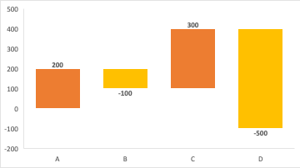
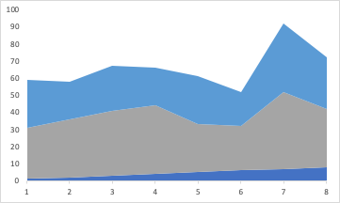
Composition
Composition will show how individual parts make up the whole.
Examples include:
Advertising spend, by medium, for a given year
Total country population by religions, languages, or ethnical groups
Total budget, by strategic objective, department, or region
Go-to visualizations: bar charts, pie charts, waterfall charts, & stacked area charts.
Waterfall chart
Stacked area chart
Notes:
The purpose of this slide is to showcase ideas for visualizing composition.
The two images are of charts that were not previously discussed:
A waterfall chart helps in understanding the cumulative effect of sequentially introduced positive or negative values. The waterfall chart is also known as a flying bricks chart or Mario chart due to the apparent suspension of columns (bricks) in mid-air. Normally used for understanding how an initial value is affected by a series of intermediate positive or negative values.
Stacked Area Charts are similar to the simple Area Chart, but here is uses multiple data series that start each point from the point left by the previous series. It is useful for comparing multiple variables changing over interval.
Optional chat question: How would you visualize the examples listed?

Slide 95
Distributions
Distributions combine comparison and composition.
Examples include:
The distribution of ages in a group of people
Identifying problems or constraints in quality control systems
Go-to visualizations: histograms, line charts, area charts, scatter plots, & maps.
Notes:
The purpose of this slide is to showcase ideas for visualizing distributions.
Optional chat question: How would you visualize the examples listed?

Slide 96
Relationships
Sometimes we want to see the relationships, correlation, or connection of two or more variables and their properties.
Examples include:
Estimating how expenditures in advertising affect sales
Spotting trouble areas by evaluating budget vs. expenses by department or region
Answering questions such as, “Does income level depend on education level?”
Go-to visualizations: scatter plots, bubble charts, & line charts.
Notes:
The purpose of this slide is to showcase ideas for visualizing relationships.
Optional chat question: How would you visualize the examples listed?

Slide 97

Metrics and KPIs
Use a dashboard to display important metrics and KPIs.
A dashboard is a collection of data visualizations assembled into a single, unified view. It often presents real-time data.
Notes:
The purpose of this slide is to introduce the concept of dashboards.

Slide 98

Polling question
What kinds of function is this chart performing?
Comparison
Composition
Distribution
Relationship
https://www.sciencedirect.com/science/article/pii/S2405844020312615
Notes:
The purpose of this slide is to get students thinking about which functions charts perform.
INVITE students to answer the questions either in the chat or by turning on their mics.
In this case, the chart shows a comparison (the frequency of energy words in different years). It also shows a relationship between speeches made by Democrats and speeches made by Republicans. It does not tell us anything about the relationship of part to whole.
PROVIDE CONTEXT: Chart appeared in an article performing text mining (topic modeling, sentiment analysis) on a corpus of nearly 1.9⋅106 congressional speeches made between 1873 and 2010, retrieved from the Congressional Record. The goal was to identify trends and changes in the content and attitude of speeches over time. For more information, see https://www.sciencedirect.com/science/article/pii/S2405844020312615
ASK AN ADDITIONAL QUESTION: What kinds of trends emerge from interpreting this data? Are there limitations to drawing conclusions about energy policy based on the words chosen to represent “energy”? (Possible answer: I would want more information about the context of each word. The words ‘electric,’ ‘oil,’ and ‘gas’ all have metaphorical meanings unrelated to the energy industry [“We’ve got to give the economy a bit more gas.”])

Slide 99

Polling question
How about this chart?
Comparison
Composition
Distribution
Relationship
https://www.worldbank.org/en/news/feature/2019/12/20/year-in-review-2019-in-charts
Notes:
The purpose of this slide is to get students thinking about which functions charts perform.
In this case, the chart performs all four functions (!!). You can compare the distribution of jobs by gender and by sector (services, agricultural, industry). You can see the relationship between different sectors by gender over time. And extrapolate conclusions. Because the y-axis represents a percentage share, the line graph also effectively replaces annual pie charts showing distribution by gender or by sector for each year (the total by gender is always 100%).
PROVIDE CONTEXT: This chart was generated based on World Development Indicator data as part of the World Bank’s 2019 Year in Review. “Where will the jobs be in the future? Current trends point toward the service sector, which became the world’s largest employer in the early 2000s and now accounts for 49% of global employment. The share of people employed in services ranges from 26% of the workforce in low-income countries to 75% in high-income countries, according to International Labour Organization data. Jobs in market (private sector) services have doubled in upper middle-income countries since 1997. Wholesale and retail trade and repair is projected to drive overall employment expansion in developing countries from 2017 to 2025, while jobs in real estate and business services are expected to grow in both middle-income and developed countries. Jobs related to accommodation and food services will expand to varying degrees everywhere, according to the ILO. Globally, women hold a greater proportion of service-sector jobs than men (55% vs. 45%), but overall, only 48% of all women participated in the workforce in 2018, compared with 75% of men.”
For more information see https://www.worldbank.org/en/news/feature/2019/12/20/year-in-review-2019-in-charts
ASK AN ADDITIONAL QUESTION: If you were to create a distribution snapshot visualization of gender data by industry, what might you like the components to be? (Possible answer: specific jobs within each sector, or shares of each sector.)

Slide 100

Polling question
DailyFX Global Commodities Interactive Tool
https://www.dailyfx.com/research/global-commodities/
Lastly, what about this interactive tool?
Comparison
Composition
Distribution
Relationship
Notes:
The purpose of this slide is to get students thinking about which functions charts perform.
For this example, OPEN the tool in your browser and play with it. SUGGEST that students do the same.
In this case, the interactive tool performs all four functions. You can compare the distribution of commodities by country, and compare imports vs. exports. You can see the relationship between different countries’ imports and exports and attempt to extrapolate conclusions. You can also see the composition of any country’s imported and exported commodities.
PROVIDE CONTEXT: “At DailyFX, we’ve created the Global Commodities interactive tool that lets you take a closer look at some of the world’s largest imports and exports. With the tool you can explore the movement, flow, and growth of commodities such as gold, oil, copper and natural gas over the last decade.” For more information see https://www.dailyfx.com/research/global-commodities/
ASK AN ADDITIONAL QUESTION: What other data would you like to see represented in this tool? When would it begin to feel overwhelming? (Possible answer: there are a lot of countries with no data represented at all! But representing too many countries without appropriate filters would be overwhelming…)

Slide 101
Activity: class survey
Turn to page 13 of your participant guide to find class survey – part II.
Review the questions from the class survey that you all took earlier.
Think about what story you could uncover or tell with the results and who you want to tell it to.
Draw a quick visualization to express how you’d like to see that story presented.
Notes:
REVIEW this slide then go on to the next to show several examples.

Slide 102


Examples
“I want to know if my classmates that own dogs got up earlier today. I created my visualization using PowerPoint.”
“I want to show my bosses that we should offer a Python programming class. I mocked this up on a scrap of paper.”
Notes:
NOTE that they don’t need to do the actual analysis (because they don’t have the results), just figure out how they’d go about it.
OFFER other suggestions to create their visualizations such as Paint or Excel

Slide 103
Recap
The type of visual you use depends primarily on two things:
The data you want to communicate
What you want to convey about that data
Notes:
The purpose of this slide is to recap the section.

Slide 104
Common charts and graphs
Choosing a visual
Reducing chart clutter
How can you make charts or graphs that are easier to read?
Notes:
The purpose of this slide is to indicate the start of the section.

Slide 105

Designing compelling visuals
Picking the right chart type isn't enough.
There are choices to be made about the elements you include and how they are formatted.
Data visualization is an art, informed by science.
We’ll start by discussing how to reduce chart clutter.
In later sections we’ll discuss visual design theory and common mistakes.
Notes:
The purpose of this slide is to transition from picking the right chart type to refining it.

Slide 106

Reducing chart clutter
Small changes can have a big effect on a visualization’s impact.
Let’s walk through some tips to make an ugly chart like this look better.
Notes:
INDICATE that we’re going to make the ugly chart on this page look better, one step at a time.

Slide 107

Remove special effects
Tip 1
Special effects, like 3D presentation, can reduce comprehension and make it difficult to compare elements and judge areas.
Notes:
The purpose of this slide is to give a tip for reducing clutter and show how that tip improves the chart shown

Slide 108

Lighten the background
Tip 2
A dark background can distract from the main message.
Notes:
The purpose of this slide is to give a tip for reducing clutter and show how that tip improves the chart shown

Slide 109

Remove chart borders
Tip 3
Simplifying chart elements like borders can help to highlight what is most important, relevant, or interesting.
Notes:
The purpose of this slide is to give a tip for reducing clutter and show how that tip improves the chart shown

Slide 110

Remove gridlines
Tip 4
Gridlines are often unnecessary and distracting.
Notes:
The purpose of this slide is to give a tip for reducing clutter and show how that tip improves the chart shown

Slide 111

Use direct labels
Tip 5
Your eyes will need to move around the page much less when you can connect the label directly to the data.
Notes:
The purpose of this slide is to give a tip for reducing clutter and show how that tip improves the chart shown

Slide 112

Clean up axis titles and labels
Tip 6
In this chart the axis titles and some labels were redundant. Eliminating them simplifies the graphic and makes it easier for your reader to process.
Notes:
The purpose of this slide is to give a tip for reducing clutter and show how that tip improves the chart shown

Slide 113

Use consistent colors
Tip 7
Using less color also makes charts less complicated and therefore easier to read.
Notes:
The purpose of this slide is to give a tip for reducing clutter and show how that tip improves the chart shown

Slide 114
Recap
Remove special effects
Lighten the background
Remove chart borders
Remove gridlines
Direct label
Clean up axis titles and labels
Use consistent colors
Notes:
The purpose of this slide is to show the difference between the chart before and after we reduced clutter.

Slide 115
End of Day 2
Questions? Comments?

